Slide 1

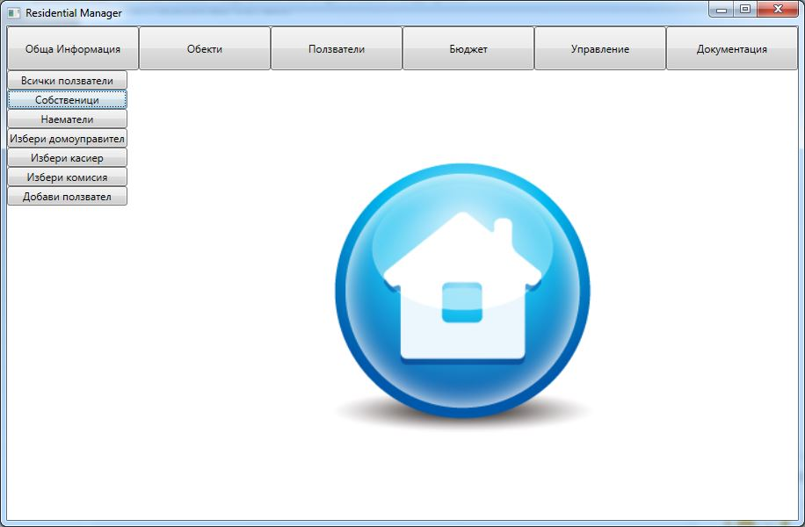
Residential Manager
The helper for the commonhold management
GOSHENITE
TEAM “GOSHENITE”:
Antoni dragomanov – dragomanov
Ivelin stanchev – teleriknetwork
Yordan bonev – Yordan.Bonev
Krasimira tsekova – KrasiTsekova
Todor todorov - ttitto

Slide 2
Residential Manager
interfaces
classes
abstract class
exception class
structure
enumeration
event
design patterns – Singleton (2),
GOSHENITE

